Slide 1
Functions

Slide 2
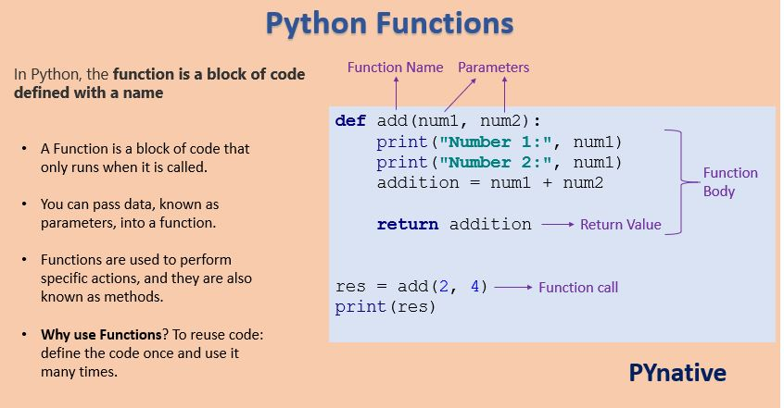
What is a function?
Set of statements that performs specific task

Slide 3
Why/when to use functions?
Rules of thumb
1. Copy-pasted code → Make a function
2. More than ~20 lines → Consider breaking up
3. Clear subtask → Probably a function
4. Used more than once → Definitely a function
5. Hard to explain what code does → Break into smaller functions

Slide 4
Function syntax
Functions are like recipes
Three main components:
Name – what the function is making (recipe title)
Inputs – what the function needs from you (ingredients)
Output (return value) – what the function returns to you (final dish)
The innards define how the function does its task (cooking steps)

Slide 5
Understanding functions
Clear and descriptive function name
Function_1 not good but get_csv_data descriptive
All needed ingredients listed and only needed ingredients
Do not list flour if it is not needed
Don’t forget the eggs
Final dish matches expectations
If the recipe says "cake," don't return soup

Slide 6
Understanding functions, part 2
When USING a function someone else wrote:
Read the name to understand what it does
Provide the required inputs
Receive the output
Inner steps are a "black box" - you don't need to know
When WRITING your own function:
Choose a clear name
Define what inputs you need
Write the inner steps (the "recipe")
Return the output

Slide 7
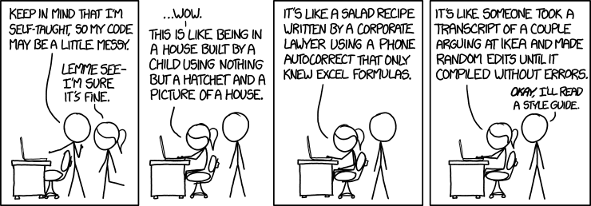
Good coding practices
Descriptive names for variables
Keep code DRY
Do not repeat yourself
Consistent coding style
Document your code
Keep code modular
Avoid global variables

Slide 8
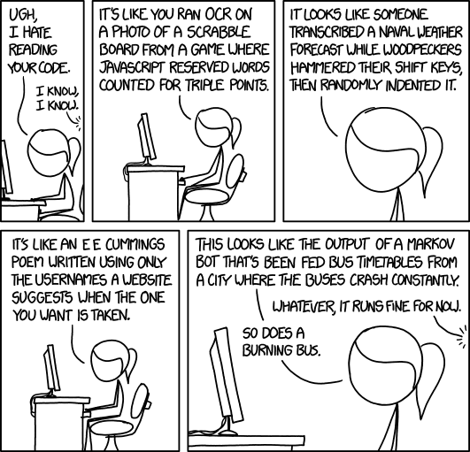
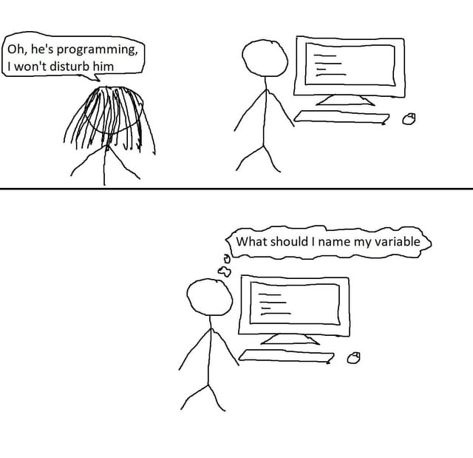

Slide 9
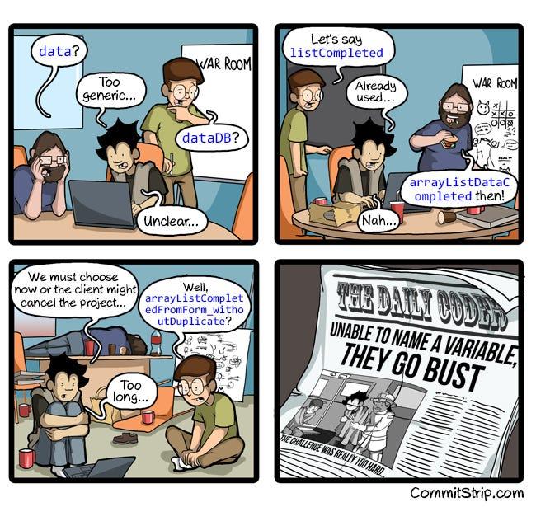
Descriptive names
Names of variables, functions, objects, etc., should provide information about content
Improves readability
Communicates intent
Reduces errors and confusion
Eases maintenance and collaboration

Slide 10
DRY (Don’t Repeat Yourself)
Repeated code = opportunity for a function
If you copy-paste code 3 times, make it a function
When you find a bug, fix it in ONE place, not everywhere
With repetition: have to remember all the places to fix
Changes become easier
update logic once, applies everywhere
Repetition creates inconsistency
easy to update one place and miss others
Functions are the tool to avoid repetition
Write once, use many times

Slide 11
Consistent coding style
Same naming style for objects functions
Lower case with underscores (snake case), for example
Consistent spacing and indentation
Tabs or space but not both
Spaces around operators for readability
X = y + 3
Not x=y+3
Consistent quotations
Single or double quotation marks

Slide 12
Document your code
Label each section to create narrative
Inline comments explain “why”
Save time in the future
Makes collaboration easier

Slide 13
Modular code
Each block performs specific tasks and only those tasks
Easier to fix if something goes wrong (like with version control)
Supports DRY principle and error testing

Slide 14
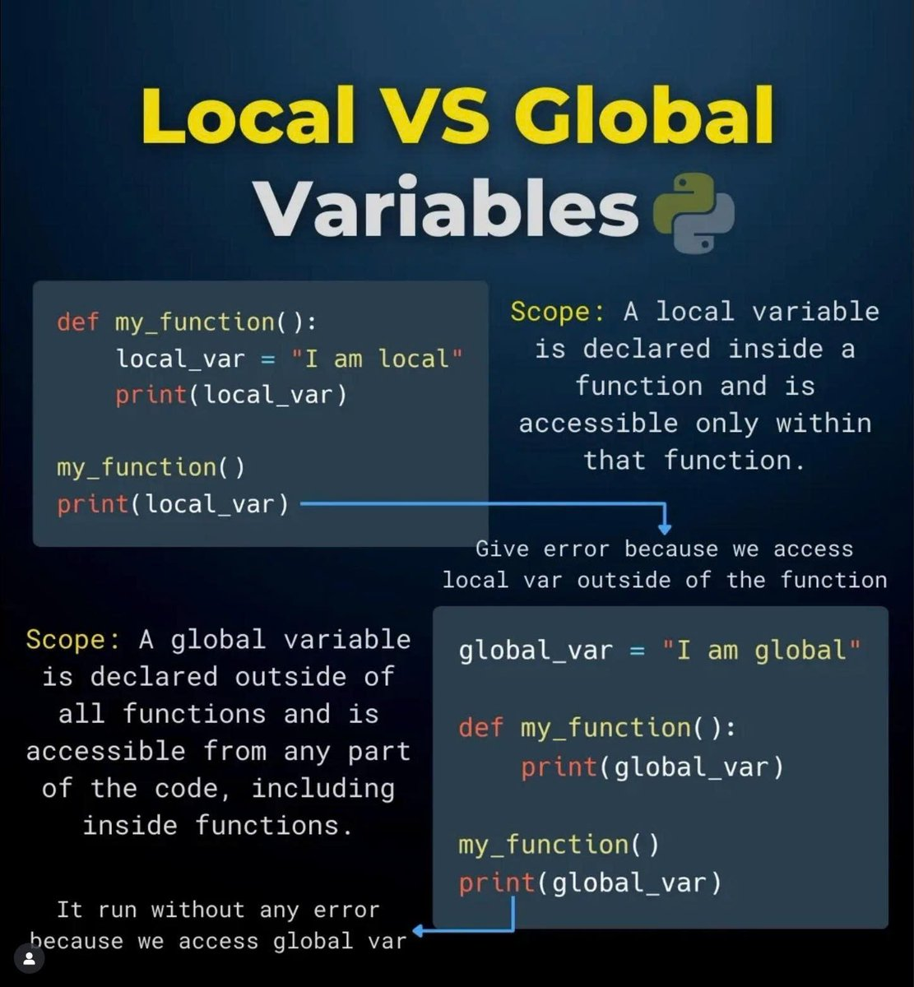
Global and local variables
Local variable: Only visible to function
Once function completes, variable disappears
Global variable: Visible outside functions
Can be read inside functions automatically
Can be changed within functions with ‘global’

Slide 15
Rules for Good Functions
Keep it simple
Make inputs explicit
Return results
Clear names for functions

Slide 16
Keep it simple
One task per function
Limited number of inputs/parameters
Simple logic over clever solutions
Avoid unnecessary features (premature generalization)
Code that is easy to read and maintain

Slide 17
Make inputs explicit
All needed information should be arguments
Avoid global variables in functions
Makes functions reusable across scripts

Slide 18
Return results
Functions should output values
Not only print to console
Building blocks
Can be inputted to other functions
Testing and debugging
Easier to verify whether functions working
Flexibility
User decides what to do with results

Slide 19
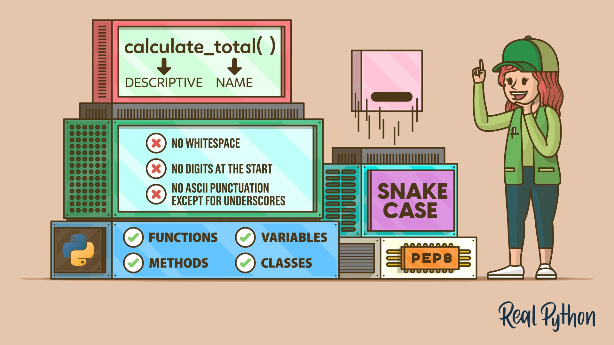
Clear names for functions
Name should describe what function does
Relates to descriptive variable names in coding practices

Slide 20
Internal v. External Functions
Internal Functions (just for you):
Research scripts, homework, personal analysis
Minimal error checking - you know the inputs
Brief or no docstrings
Optimize for getting work done quickly
External Functions (for others):
Shared code, packages, team projects
Extensive error checking and validation
Detailed docstrings
Optimize for clarity and robustness

Slide 21
Examples
External function
def growth_rate(current, previous): “”” Calculate the percentage growth rate between two values. Parameters ---------- current : float or int The current value. previous : float or int The previous value. Must be nonzero. Returns ------- float The growth rate, defined as (current - previous) / previous. “”” # Type checking if not isinstance(current, (int, float)): raise TypeError("current must be numeric") if not isinstance(previous, (int, float)): raise TypeError("previous must be numeric") # Value checking if previous == 0: raise ValueError("previous must be nonzero") return (current - previous) / previous
Internal function
def _growth_rate(current, previous):
# assumes previous != 0 and inputs are numeric
return (current - previous) / previous

Slide 22
<ENT>Framed, matted, and signed photographic portrait of Prince William. Rec'd—12/8/2014. Est. Value—$888.00. Disposition—National Archives and Records Administration</ENT>
# Function to extract and clean the columns
def extract_and_clean(df, column_name, regex_pattern, replace_pattern):
df['itemt']=df.item
df[[ 'item', column_name]] = df['item'].str.extract(regex_pattern, flags=re.M)
df[column_name] = df[column_name].str.replace(replace_pattern, '', regex=True).str.strip()
df[column_name] = df[column_name].str.replace(r'\.$','', regex=True)
df['item'] = df['item'].fillna(df['itemt'])

